Slide 1

Igraph: An introduction
Sebastian Robledo Ph.D.(c)
Notes:
This is not an introduction to R

Slide 2
INTRODUCTION
EXAMPLE
IGRAPH
PRACTICE
R language has become very popular between researchers because it let them do sophisticated statistical calculations to a lot of data and with the support of a huge community.
Purpose
The purpose of this session is to introduce the participants to the main technical concepts of network data analysis in R using igraph, for example: how to read data from R, how to convert this data to a graph object and how to do some descriptive analysis.
Methodology
Just run the code!
The objective is to focus On the main features of igraph (what can we do with it?) and avoid the thecnical problems.
Igraph: An introduction
Notes:
Present the files: R, presentations, etc

Slide 3


INTRODUCTION
EXAMPLE
IGRAPH
PRACTICE
Statistical Analysis of Network Data with R
A User’s Guide to Network Analysis in R
Igraph: An introduction

Slide 4
INTRODUCTION
EXAMPLE
IGRAPH
PRACTICE
Useful links
Datasets
Triads Go Boink!
Longitudinal Network Data Sources
Network Analysis and Visualization with R and igraph
Network Datasets
Social Network Analysis Labs in R and SoNIA
The Koblenz Network Collection
Examples...
Stanford Large Network Dataset Collection
Igraph: An introduction

Slide 5

INTRODUCTION
EXAMPLE
IGRAPH
PRACTICE
Getting Data
Cleaning Data
Tidying Data
Exploratory Analysis
Results
Question
What are the most important papers in a research topic using graph theory?
High in-degree and 0 out-degree
High Betweeness
High out-degree and 0 in-degree
Seminals
Structurals
Current
Igraph: An introduction

Slide 6
INTRODUCTION
EXAMPLE
IGRAPH
PRACTICE
Getting Data
Cleaning Data
Tidying Data
Exploratory Analysis
Results
Data
TITLE: (social networks) AND TOPIC: (organization)
306 papers
Web of Science
Igraph: An introduction
Notes:
Check que equation...

Slide 7
INTRODUCTION
EXAMPLE
IGRAPH
PRACTICE
Getting Data
Cleaning Data
Tidying Data
Exploratory Analysis
Results
K
L1
L2
C
R2.1
T1
R3
R2.1
T1
T2
T3
R2
R3
A
A
E
L1
R3
I
L3
T1
T2
R2
L2
H
R2
T3
R1
B
R2
K
C
R1
T3
J
D
F
T2
T3
I
J
L3
G
R2
D
E
R2
F
G
H
H
B
Igraph: An introduction

Slide 8
INTRODUCTION
EXAMPLE
IGRAPH
PRACTICE
Getting Data
Cleaning Data
Tidying Data
Exploratory Analysis
Results
K
Deleting nodes with in-degre = 1 and out-degree = 0
C
R2.1
T1
A
T1
E
L1
R3
I
L1
R3
T2
R2
L2
I
H
T2
R2
L2
R1
T3
H
J
D
F
R1
T3
L3
J
G
L3
B
Igraph: An introduction

Slide 9
INTRODUCTION
EXAMPLE
IGRAPH
PRACTICE
Getting Data
Cleaning Data
Tidying Data
Exploratory Analysis
Results
Extracting the giant component
T1
T1
I
L1
R3
L1
R3
H
T2
R2
L2
T2
R2
L2
J
R1
T3
R1
T3
L3
L3
Igraph: An introduction

Slide 10
INTRODUCTION
EXAMPLE
IGRAPH
PRACTICE
Getting Data
Cleaning Data
Tidying Data
Exploratory Analysis
Results
Deleting in and out degree attributes
net.tidied.2 <- delete_vertex_attr(net.tidied.1, "outdegree" ) net.tidied.3 <- delete_vertex_attr(net.tidied.2, "indegree" ) net.tidied <- net.tidied.3 summary(net.tidied)
IGRAPH DN-- 1062 3115 -- + attr: name (v/c), label (v/c)
Igraph: An introduction

Slide 11
INTRODUCTION
EXAMPLE
IGRAPH
PRACTICE
Getting Data
Cleaning Data
Tidying Data
Exploratory Analysis
Results
Global Properties
Diameter
diameter(net.tidied, directed = TRUE, weights = NA)
Centralization
centr_degree(net.tidied, mode = "all")$centralization
Density
graph.density(net.tidied)
Transitivity
transitivity(net.tidied, type = "global")
Igraph: An introduction

Slide 12
INTRODUCTION
EXAMPLE
IGRAPH
PRACTICE
Getting Data
Cleaning Data
Tidying Data
Exploratory Analysis
Results
Local Properties
Bonacich
V(net.tidied)$bonacich <- power_centrality(net.tidied)
Transitivity
V(net.tidied)$transitivity <- transitivity(net.tidied, type = "local") head(as_data_frame(net.tidied, what = "vertices"))
Degree: in and out
V(net.tidied)$indegree <- degree(net.tidied, mode = "in")
V(net.tidied)$outdegree <- degree(net.tidied, mode = "out") V(net.tidied)$degree <- degree(net.tidied, mode = "all")
Betweenness
V(net.tidied)$bet <- betweenness(net.tidied)
Igraph: An introduction

Slide 13
INTRODUCTION
EXAMPLE
IGRAPH
PRACTICE
Getting Data
Cleaning Data
Tidying Data
Exploratory Analysis
Results
Subgroups and communities
Coreness
V(net.tidied)$coreness <- coreness(net.tidied)
Based on greedy optimization of modularity
community <- cluster_fast_greedy(as.undirected(net.tidied)) V(net.tidied)$community <- community$membership
Igraph: An introduction

Slide 14
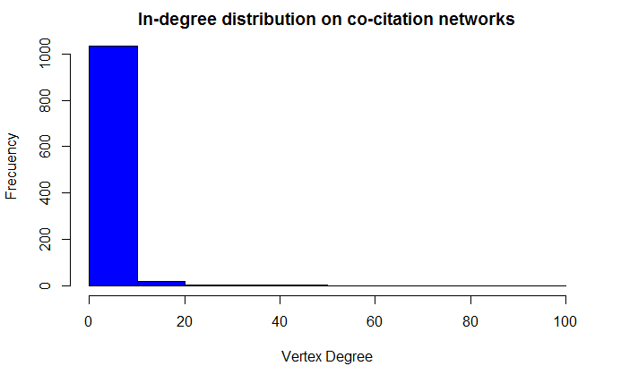
INTRODUCTION
EXAMPLE
IGRAPH
PRACTICE
Getting Data
Cleaning Data
Tidying Data
Exploratory Analysis
Results
Topological Properties
Degree Distribution
hist(degree(net.tidied, mode = "in"), col="blue", main = "In-degree distribution on co-citation networks", xlab = "Vertex Degree", ylab = "Frecuency")
Igraph: An introduction

Slide 15
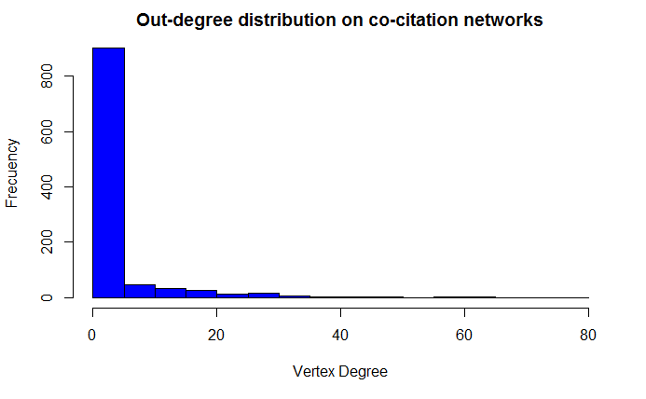
INTRODUCTION
EXAMPLE
IGRAPH
PRACTICE
Getting Data
Cleaning Data
Tidying Data
Exploratory Analysis
Results
Topological Properties
Degree Distribution
hist(degree(net.tidied, mode = "out"), col="blue", main = "Out-degree distribution on co-citation networks", xlab = "Vertex Degree", ylab = "Frecuency")
Igraph: An introduction

Slide 16
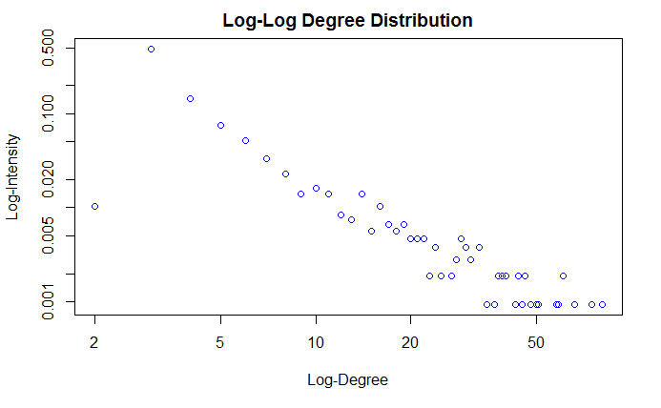
INTRODUCTION
EXAMPLE
IGRAPH
PRACTICE
Getting Data
Cleaning Data
Tidying Data
Exploratory Analysis
Results
Topological Properties
Log - Log Degree Distribution
d.net.tidied <- degree(net.tidied, mode = "all") dd.net.tidied <- degree.distribution(net.tidied) d <- 1:max(d.net.tidied) ind <- (dd.net.tidied != 0) plot(d[ind], dd.net.tidied[ind], log = "xy", col = "blue", xlab = c("Log-Degree"), ylab = c("Log-Intensity"), main = "Log-Log Degree Distribution")
Igraph: An introduction

Slide 17
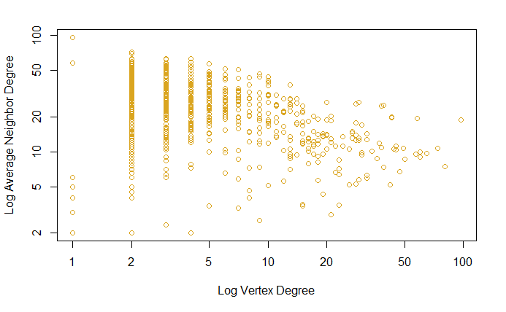
INTRODUCTION
EXAMPLE
IGRAPH
PRACTICE
Getting Data
Cleaning Data
Tidying Data
Exploratory Analysis
Results
Topological Properties
Log - Log Average Neighbor Degree
a.nn.deg.net.tidied <- graph.knn(net.tidied,V(net.tidied))$knn plot(d.net.tidied, a.nn.deg.net.tidied, log="xy", col="goldenrod", xlab=c("Log Vertex Degree"), ylab=c("Log Average Neighbor Degree"))
Igraph: An introduction

Slide 18
INTRODUCTION
EXAMPLE
IGRAPH
PRACTICE
Getting Data
Cleaning Data
Tidying Data
Exploratory Analysis
Results
Identifidying key actors in the network: Seminal, Structural, and Current papers
df.1 <- as_data_frame(net.tidied, what = "vertices") df.1 <- df.1[, c("label", "outdegree", "indegree", "bet")] seminals <- df.1[df.1$outdegree == 0,] seminals <- head(seminals[order(seminals$indegree, rev(seminals$indegree), decreasing = TRUE), "label"], 10) structurals <- head(df.1[order(df.1$bet, rev(df.1$bet), decreasing = TRUE), "label"], 10) currents <- df.1[df.1$indegree == 0,] currents <- head(currents[order(currents$outdegree, rev(currents$outdegree), decreasing = TRUE), "label"], 10) key.papers <- data.frame(seminals, structurals, currents, stringsAsFactors = FALSE)
Igraph: An introduction

Slide 19
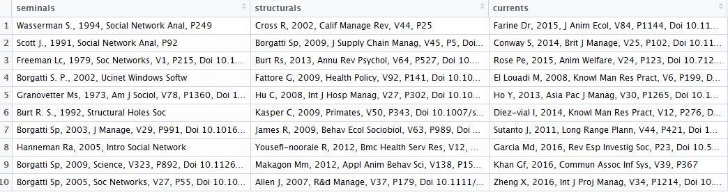
INTRODUCTION
EXAMPLE
IGRAPH
PRACTICE
Getting Data
Cleaning Data
Tidying Data
Exploratory Analysis
Results
Identifidying key actors in the network: Seminal, Structural, and Current papers
Igraph: An introduction

Slide 20
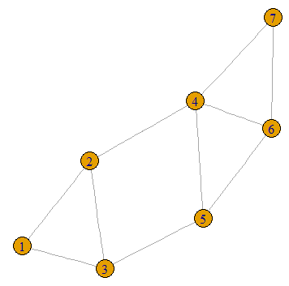


INTRODUCTION
EXAMPLE
IGRAPH
PRACTICE
Creating Graphs: Undirected
Graph Data
Plotting
library(igraph)
library(sand)
Create a graph object g with N = 7 vertices
g <- graph.formula(1-2, 1-3, 2-3, 2-4, 3-5, 4-5, 4-6, 4-7, 5-6, 6-7)
To see the vertices
V(g)
To see the edges
E(g)
Igraph: An introduction

Slide 21
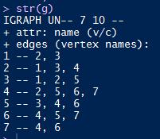
INTRODUCTION
EXAMPLE
IGRAPH
PRACTICE
Creating Graphs: Undirected
Graph Data
Plotting
More compressed format
str(g)
UN : Undirected
UNW: Undirected + Weighted
plot(g)
Igraph: An introduction

Slide 22
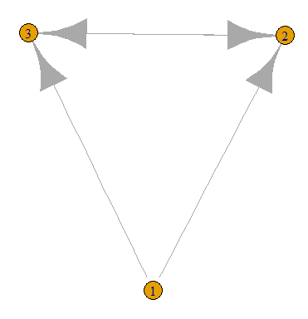
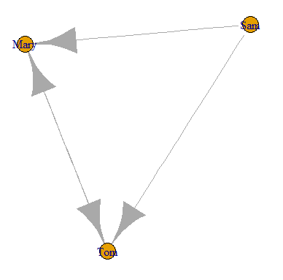
INTRODUCTION
EXAMPLE
IGRAPH
PRACTICE
Creating Graphs: Directed
Graph Data
Plotting
dg <- graph.formula(1-+2, 1-+3, 2++3)
plot(dg)
dg.1 <- graph.formula(Sam-+Mary, Sam-+Tom, Mary++Tom)
plot(dg.1)
Igraph: An introduction

Slide 23
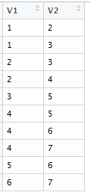
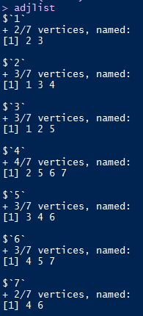
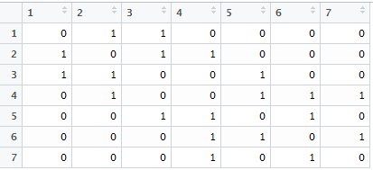
INTRODUCTION
EXAMPLE
IGRAPH
PRACTICE
Creating Graphs: Representations
Graph Data
Plotting
edgelist <- get.edgelist(g)
View(edgelist)
matrix <- as.matrix(get.adjacency(g))
View(matrix)
adjlist <- get.adjlist(g)
adjist
Igraph: An introduction

Slide 24
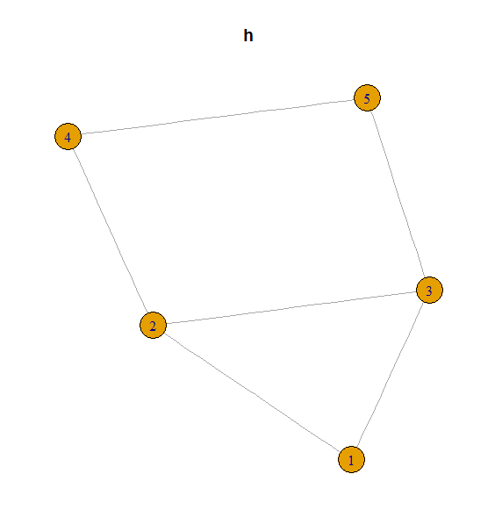
INTRODUCTION
EXAMPLE
IGRAPH
PRACTICE
Creating Graphs: Operations
Graph Data
Plotting
Consider the subgraph of g induced by the first five vertices.
h <- induced.subgraph(g, 1:5)
plot(h)
Also, we could remove vertices 6 and 7 from g to generate h
h <- g - vertices(c(6,7))
Recovering g from h by adding these two vertices and the apropiate edges
h <- h + vertices(c(6,7))
plot(h)
g <- h + edges(c(4,6),c(4,7),c(5,6),c(6,7))
plot(g)
Igraph: An introduction

Slide 25
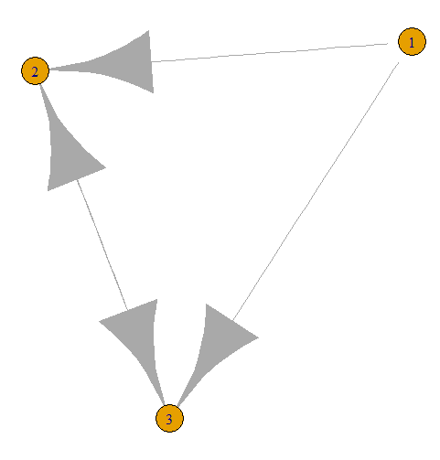
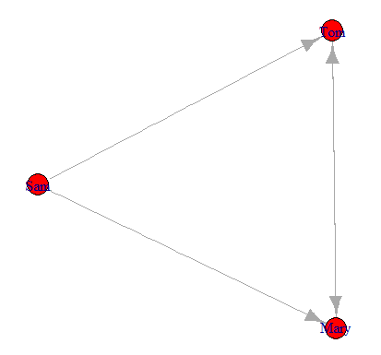
INTRODUCTION
EXAMPLE
IGRAPH
PRACTICE
Creating Graphs
Graph Data: Adding Attributes
Plotting
dg.2 <- graph.formula(1-+2, 1-+3, 2++3)
plot(dg.1)
Adding a name to our graph
dg.2$name <- "Toy Graph"
Adding names to our nodes
V(dg.2)$name <- c("Sam", "Mary", "Tom")
Adding gender to our nodes
V(dg.2)$gender <- c("M","F","M")
Adding color to our nodes
V(dg.2)$color <- "red"
summary(dg.2)
plot(dg.2)
Igraph: An introduction

Slide 26
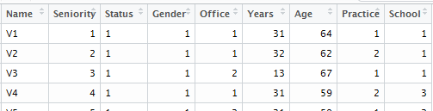
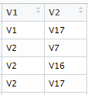
INTRODUCTION
EXAMPLE
IGRAPH
PRACTICE
Creating Graphs
Graph Data: Dataframes
Plotting
library(sand)
View vertices and edges
View(elist.lazega)
View(v.attr.lazega)
Convert them into a graph object (g.lazega)
g.lazega <- graph.data.frame(elist.lazega, directed="FALSE", vertices=v.attr.lazega)
elist.lazega
Checking the values of the graph
vcount(g.lazega)
ecount(g.lazega)
list.vertex.attributes(g.lazega)
summary(g.lazega)
Igraph: An introduction

Slide 27
INTRODUCTION
EXAMPLE
IGRAPH
PRACTICE
Creating Graphs
Graph Data: Importing/Exporting
Plotting
Uploading vertices and edges
Convert them into a graph object (g.lazega.1)
vertices <- read.csv("vertices.csv", stringsAsFactors = FALSE)
g.lazega.1 <- graph.data.frame(edges, directed = "FALSE",
vertices = vertices)
edges <- read.csv("edges.csv", stringsAsFactors = FALSE)
Uploading graph object
lazega <- read.graph("lazega.graphml", format = "graphml")
summary(lazega)
plot(lazega)
Uploading matrix file
matrix.lazega <- read.csv("matrix_1.csv", stringsAsFactors = FALSE)
matrix.lazega.1 <- as.matrix(matrix.lazega)
summary(g.matrix.lazega )
g.matrix.lazega <- graph.adjacency(adjmatrix = matrix.lazega.1, mode = "undirected")
Igraph: An introduction

Slide 28
INTRODUCTION
EXAMPLE
IGRAPH
PRACTICE
Creating Graphs
Graph Data: Importing/Exporting
Plotting
Exporting graph objects as vertices and edges
write.csv(v.attr.lazega, "lazega_vertices.csv", row.names = FALSE)
write.csv(elist.lazega, "lazega_edges.csv", row.names = FALSE)
Exporting graph objects as graph objects
write.graph(g.lazega, "lazega.graphml", format = "graphml")
Igraph: An introduction

Slide 29
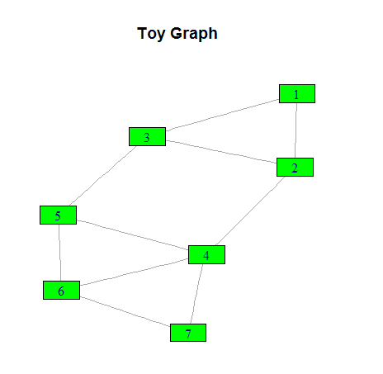
INTRODUCTION
EXAMPLE
IGRAPH
PRACTICE
Creating Graphs
Graph Data: Importing/Exporting
Plotting: Example I
plot(g, vertex.size = 30, vertex.shape = "rectangle", vertex.color = "green")
title("Toy Graph")
Igraph: An introduction

Slide 30
INTRODUCTION
EXAMPLE
IGRAPH
PRACTICE
Creating Graphs
Graph Data: Importing/Exporting
Plotting: Example II
library(igraphdata)
data(karate)
set.seed(42)
l <- layout.kamada.kawai(karate)
par(mfrow=c(1,1))
plot(karate, layout=l, vertex.label=NA)
V(karate)$label <- sub("Actor ", "", V(karate)$name)
V(karate)$shape <- "circle"
V(karate)[c("Mr Hi", "John A")]$shape <- "rectangle"
V(karate)[Faction == 1]$color <- "red"
V(karate)[Faction == 2]$color <- "dodgerblue"
V(karate)$size <- 4*sqrt(graph.strength(karate))
V(karate)$size2 <- V(karate)$size * .5
E(karate)$width <- E(karate)$weight
F1 <- V(karate)[Faction==1]
F2 <- V(karate)[Faction==2]
E(karate)[ F1 %--% F1 ]$color <- "pink"
E(karate)[ F2 %--% F2 ]$color <- "lightblue"
E(karate)[ F1 %--% F2 ]$color <- "yellow"
V(karate)$label.dist <-
ifelse(V(karate)$size >= 10, 0, 0.75)
plot(karate, layout=l)
Igraph: An introduction

Slide 31
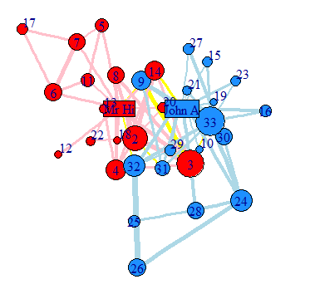
INTRODUCTION
EXAMPLE
IGRAPH
PRACTICE
Creating Graphs
Graph Data: Importing/Exporting
Plotting: Example II
Igraph: An introduction

Slide 32
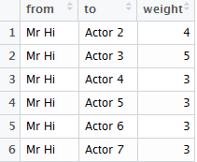
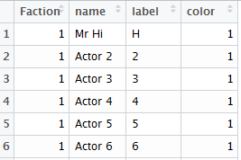
INTRODUCTION
EXAMPLE
IGRAPH
PRACTICE
Getting Data
Cleaning Data
Tidying Data
Exploratory Analysis
Restults
We are going to do an exploratory analysis of karate dataset
karate.vertices <- read.csv("Practice_karate_vertices.csv", stringsAsFactors = FALSE)
karate.edges <- read.csv("Practice_karate_edges.csv", stringsAsFactors = FALSE)
View(head(karate.edges))
View(head(karate.vertices))
Zachary, Wayne W. "An information flow model for conflict and fission in small groups." Journal of anthropological research 33.4 (1977): 452-473.
Igraph: An introduction

Slide 33
INTRODUCTION
EXAMPLE
IGRAPH
PRACTICE
Getting Data
Cleaning Data
Tidying Data
Exploratory Analysis
Restults
Now, we need to create our graph object
net.karate <- graph.data.frame(karate.edges, directed = FALSE)
summary(net.karate)
IGRAPH UNW- 34 78 --
+ attr: name (v/c), Faction (v/n), weight (e/n)
Igraph: An introduction

Slide 34
INTRODUCTION
EXAMPLE
IGRAPH
PRACTICE
Getting Data
Cleaning Data
Tidying Data
Exploratory Analysis
Restults
Adding attributes to vertices
net.karate.1 <- set.vertex.attribute(net.karate, name = "Faction",
value = karate.vertices$Faction)
net.karate.2 <- set.vertex.attribute(net.karate, name = "label",
value = karate.vertices$label)
net.karate.3 <- set.vertex.attribute(net.karate, name = "color",
value = karate.vertices$color)
net.karate.tidied <- net.karate.3
summary(net.karate.tidied)
IGRAPH UNW- 34 78 --
+ attr: name (v/c), Faction (v/n), color (v/n), weight (e/n)
Igraph: An introduction

Slide 35
INTRODUCTION
EXAMPLE
IGRAPH
PRACTICE
Getting Data
Cleaning Data
Tidying Data
Exploratory Analysis
Restults
Global properties
Density
edge_density(net.karate.tidied, loops = FALSE)
Transitivity
transitivity(net.karate.tidied, type = "global")
Diameter
diameter(net.karate.tidied, directed = TRUE, weights = NA)
Centralization
centr_degree(net.karate.tidied, mode = "all")$centralization
Igraph: An introduction

Slide 36
INTRODUCTION
EXAMPLE
IGRAPH
PRACTICE
Getting Data
Cleaning Data
Tidying Data
Exploratory Analysis
Restults
Local properties
Degree
V(net.karate.tidied)$degree <- degree(net.karate.tidied, mode = "all")
Betweenness
V(net.karate.tidied)$bet <- betweenness(net.karate.tidied)
Bonacich
V(net.karate.tidied)$bonacich <- power_centrality(net.karate.tidied)
Transitivity
V(net.karate.tidied)$transitivity <- transitivity(net.karate.tidied, type = "local")
View(head(as_data_frame(net.karate.tidied, what = "vertices")))
Igraph: An introduction

Slide 37
INTRODUCTION
EXAMPLE
IGRAPH
PRACTICE
Getting Data
Cleaning Data
Tidying Data
Exploratory Analysis
Restults
Subgroups and communities
Greedy optimization of modularity
community <- cluster_fast_greedy(as.undirected(net.karate.tidied))
V(net.karate.tidied)$community <- community$membership
table(V(net.karate.tidied)$community)
Coreness
V(net.karate.tidied)$coreness <- coreness(net.karate.tidied)
table(V(net.karate.tidied)$coreness)
Igraph: An introduction

Slide 38
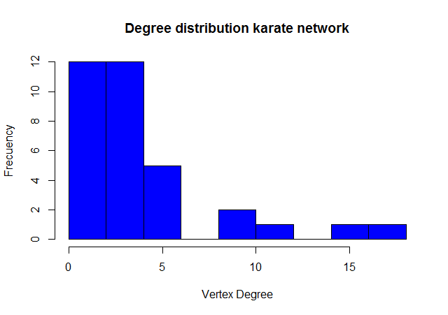
INTRODUCTION
EXAMPLE
IGRAPH
PRACTICE
Getting Data
Cleaning Data
Tidying Data
Exploratory Analysis
Restults
Topological Properties
Degree distribution
hist(degree(net.karate.tidied, mode = "all"), col="blue",
main = "Degree distribution karate network",
xlab = "Vertex Degree", ylab = "Frecuency")
Igraph: An introduction

Slide 39
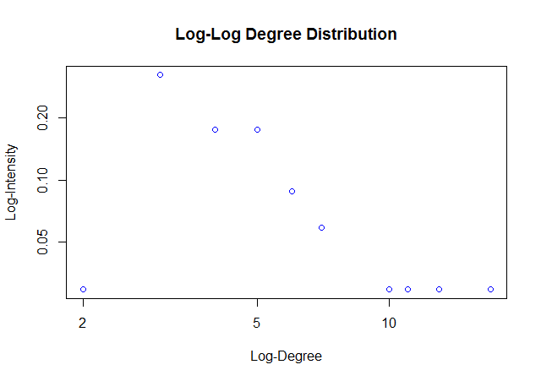
INTRODUCTION
EXAMPLE
IGRAPH
PRACTICE
Getting Data
Cleaning Data
Tidying Data
Exploratory Analysis
Restults
Topological Properties
Log - log Degree distribution
d.net.karate.tidied <- degree(net.karate.tidied, mode = "all")
dd.net.karate.tidied <- degree.distribution(net.karate.tidied)
d <- 1:max(d.net.karate.tidied)
ind <- (dd.net.karate.tidied != 0)
plot(d[ind], dd.net.karate.tidied[ind], log = "xy", col = "blue",
xlab = c("Log-Degree"), ylab = c("Log-Intensity"),
main = "Log-Log Degree Distribution")
Igraph: An introduction

Slide 40
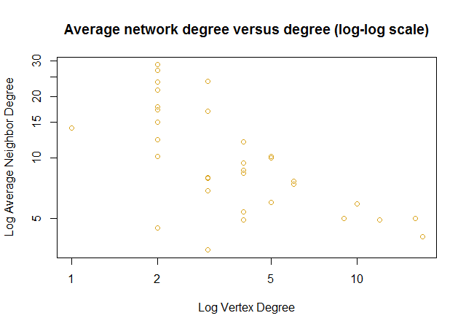
INTRODUCTION
EXAMPLE
IGRAPH
PRACTICE
Getting Data
Cleaning Data
Tidying Data
Exploratory Analysis
Restults
Topological Properties
Average network degree versus vertex degree
a.nn.deg.net.karate.tidied <- graph.knn(net.karate.tidied,
V(net.karate.tidied))$knn
plot(d.net.karate.tidied, a.nn.deg.net.karate.tidied,
log="xy", col="goldenrod",
xlab=c("Log Vertex Degree"),
ylab=c("Log Average Neighbor Degree"),
main =
"Average network degree versus degree (log-log scale)")
Igraph: An introduction

Slide 41
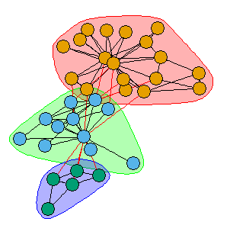
INTRODUCTION
EXAMPLE
IGRAPH
PRACTICE
Getting Data
Cleaning Data
Tidying Data
Exploratory Analysis
Restults
Visualization
kc <- fastgreedy.community(net.karate.tidied)
plot(kc, net.karate.tidied, vertex.label = NA)
Igraph: An introduction

Slide 42
INTRODUCTION
EXAMPLE
IGRAPH
PRACTICE
Getting Data
Cleaning Data
Tidying Data
Exploratory Analysis
Restults
THANKS!
Igraph: An introduction

